Slide 1
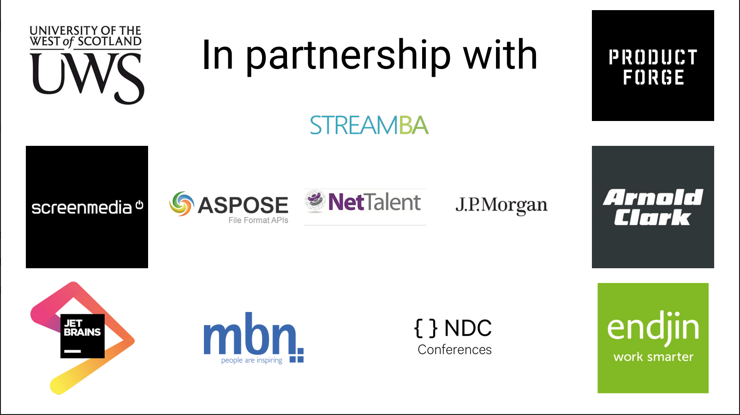

Slide 2

Writing simpler ASP.NET Core
It’s the future!!
Come join the Not So SOLID Crew!
Notes:
Thanks to the team at DDDScotland for putting this on. This is the second time I’ve been to Scotland, first time when I was about 7-8. We supposed to be here for 2 weeks but after constant torrential rain for a week my father decided he’d had enough of Scotland and we came home early. Glad to see its [stayed the same][ improved]
That’s a reference for those who are down with the kids like me using a pop group from 15 years ago!

Slide 3
Who am I?
I asked Twitter to write my profile!
@mrsacs
@danbarua
J Channon - he's alright but he smells a bit. Couch for sale.
Possesses all five fingers on each hand, leading one to suspect he's not really from round 'ere. "He's not so bad when you get to know him.
@joe_stead
@chrissie1
MVP, Architect, Twitter Complainer, GitHub enthusiast.
Said no-one ever
@ntcoding
@luisrudge
Johnny Chanson. A World Class village idiot with deep expertise in circumventing the best features of type safe programming languages. In addition he is literally a canon
Knows his shit
@morcs
@jchannon
Oursourcer of bios
Got into OSS, got child named after him, isn't that right @khellang ?!
Notes:
Who ready my profile before coming to this session?
And you still came?

Slide 4

Jonathan Channon
Another Random Developer
Software Developer, @NancyFX MVM, @omnisharp Sublime Plugin Author, Botwin author, Microsoft ASPNet MVP, Husband, Father & All Round Nice Guy!
 http://www.vqcomms.com
 https://github.com/jchannon  https://twitter.com/jchannon → jonathan.channon@gmail.com
Notes:
VQ are hiring!

Slide 5
SOLID Design Principle
As a rock!
S
O
L
I
D
Single Responsibility
Open/Close
Liskov Substitution
Interface Segregation
Dependency Injection
A class should have one, and only one, reason to change.
You should be able to extend a classes behavior, without modifying it.
Derived classes must be substitutable for their base classes.
Make fine grained interfaces that are client specific.
Depend on abstractions, not on concretions.
https://www.microsoft.com/net/learn/architecture
Notes:
SOLID has been used for the past 10 years or so and most developers learn this pattern and apply it at all new projects they start on, tell others to use it. It’s copy and pasted from each project.
It’s so engrained into developers development process that we don’t question it.
In fact Microsoft have written some new documentation for application architecture for microservices & docker, modernizing .net apps and new ASP.Net Core apps. Guess what the underlying theme is in their application design?!

Slide 6
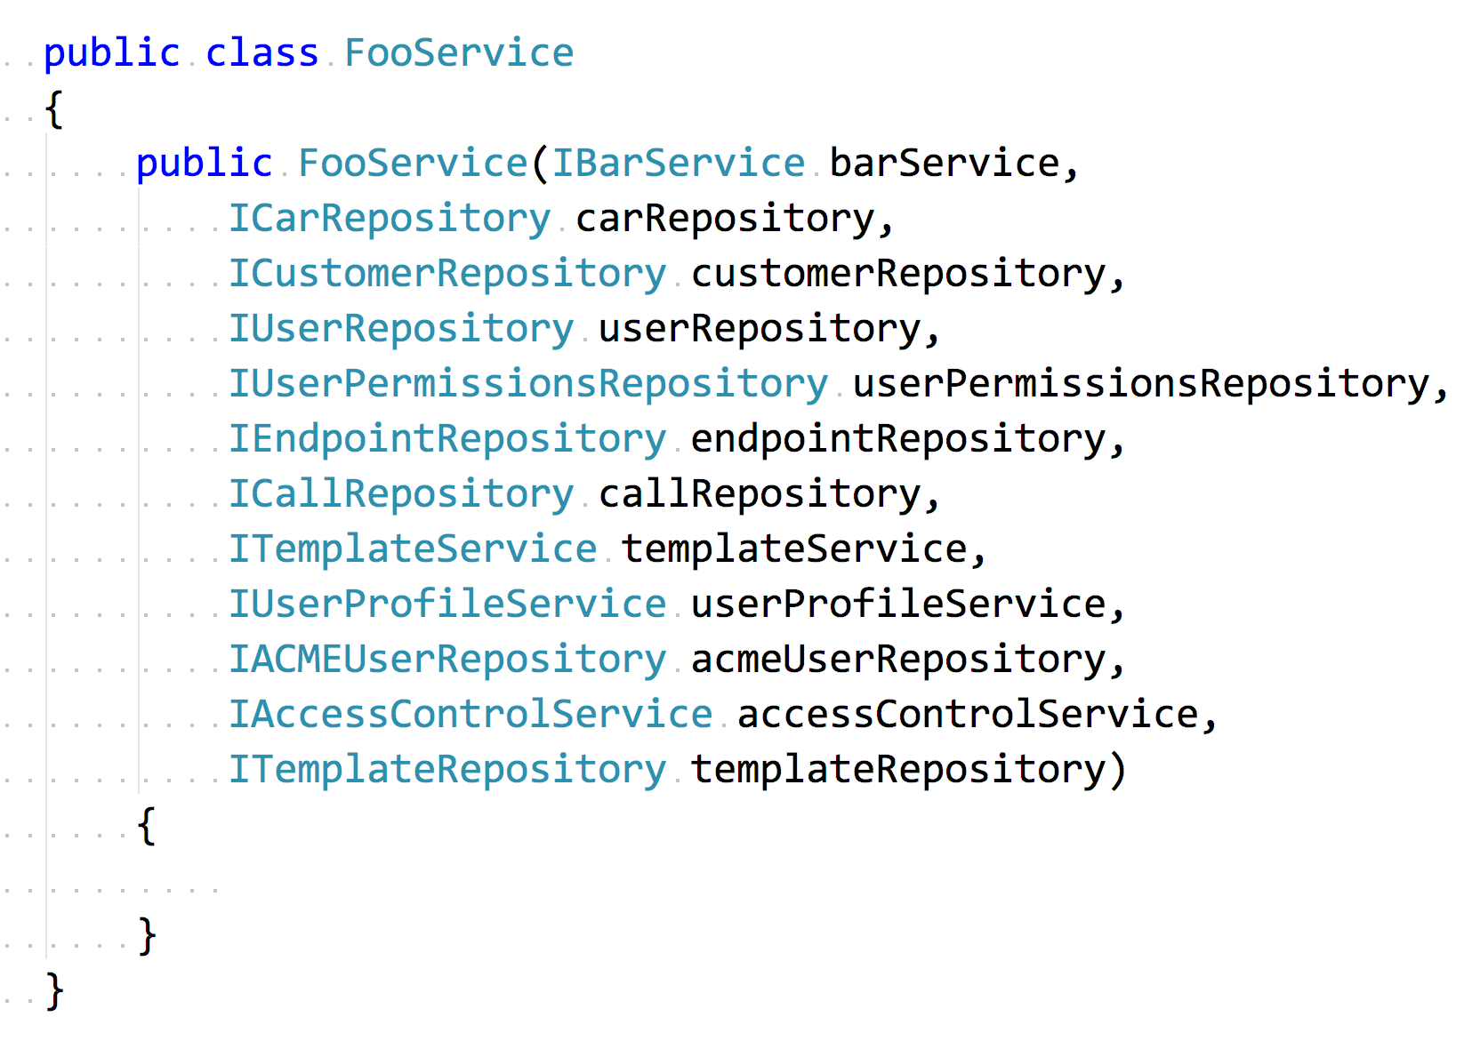
Exhibit A
You honour!
Notes:
Have any of you seen something like this before?
I ran some dotTrace profiling on our application and one area it picked up was reflection was being slow.
I thought to myself we don’t use reflection anywhere then realised it was complaining about constructors so it must have been my IOC container because under the hood that’s all its doing, finding ctor types and create an instance with those types passed to it.

Slide 7
What to do?
It’s not all what it cracked up to be!
Swap IOC containers
We swapped out to a few containers and tried others
Analyse dependencies
How was each dependency used, was it used in a couple of places for example
More S in SOLID
Create more specific classes rather than a God service class
Consolidate
Put behaviour in one central place rather than abstracting for the sake of it
KISS
Write simple, readable code!

Slide 8
Project Morphing Time!
Show me the code
SOLID
MediatR
My MediatR
Functional
◉
◉
◉

Demo 1
Demo 2
Demo 3
Demo 4
An example of a typical SOLID web application
A look at MediatR and how we can consolidate behaviour and use dependencies only when we need them.
How can we lose our dependency on MediatR? That’s right, roll our own!
Magic time! Here we will remove our IOC containers and mock libraries

Slide 9

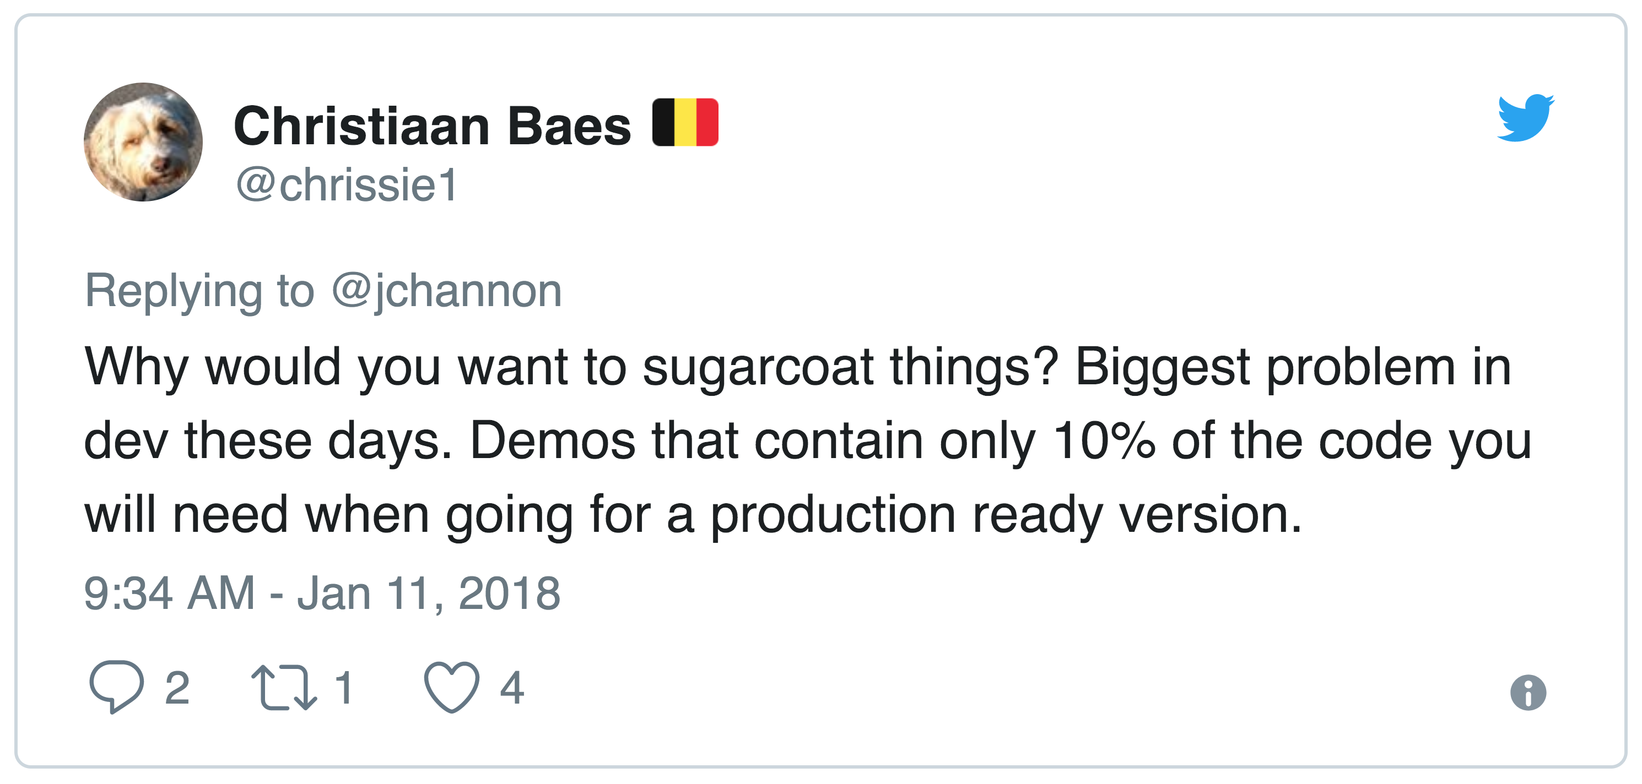

Demo Time!
Let’s Do This!
Notes:
I heard people talking about the approach to no mocks and no ioc and had always thought in my head how would you even do that and one possible solution I had was very messy. That was until I read a blog post from Mike Hadlow, him of EasynetQ fame!

Slide 10
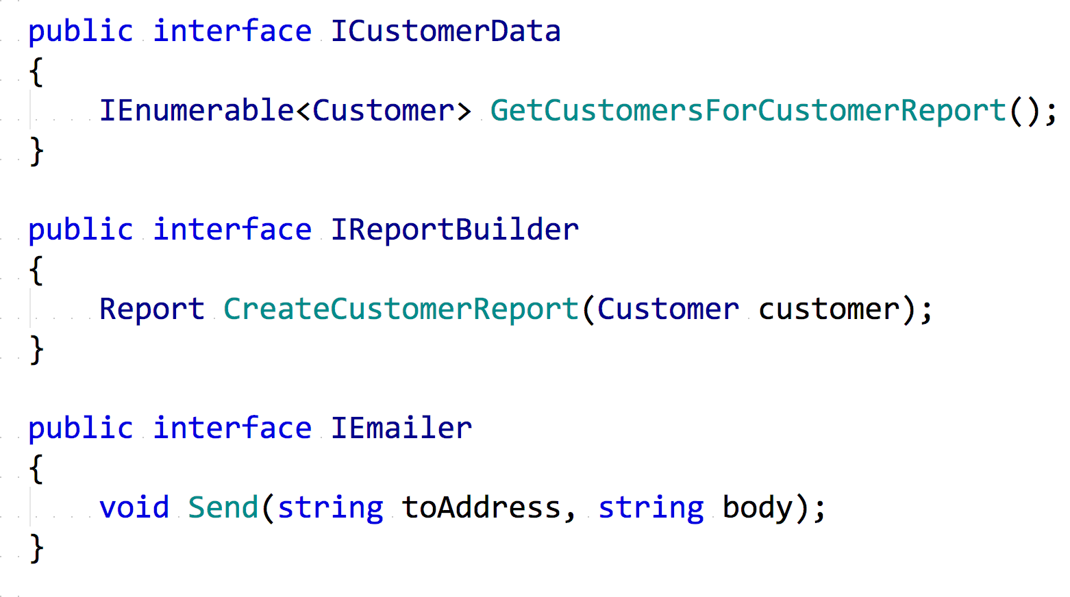

Slide 11
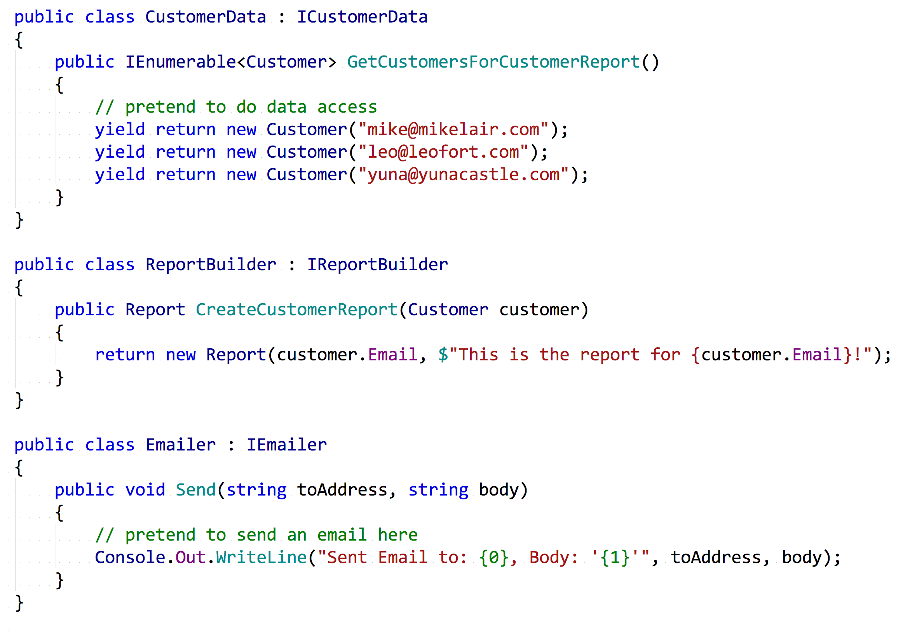

Slide 12
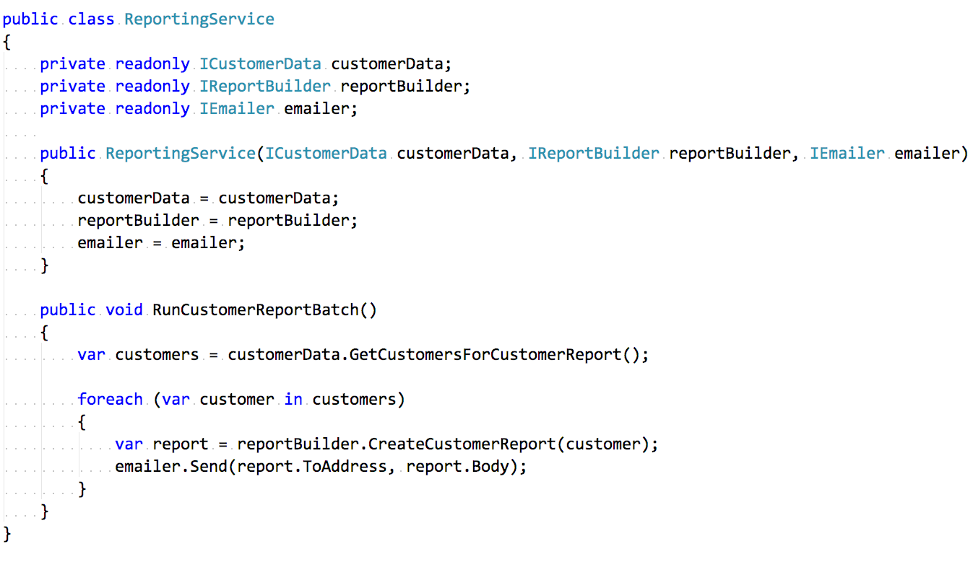

Slide 13
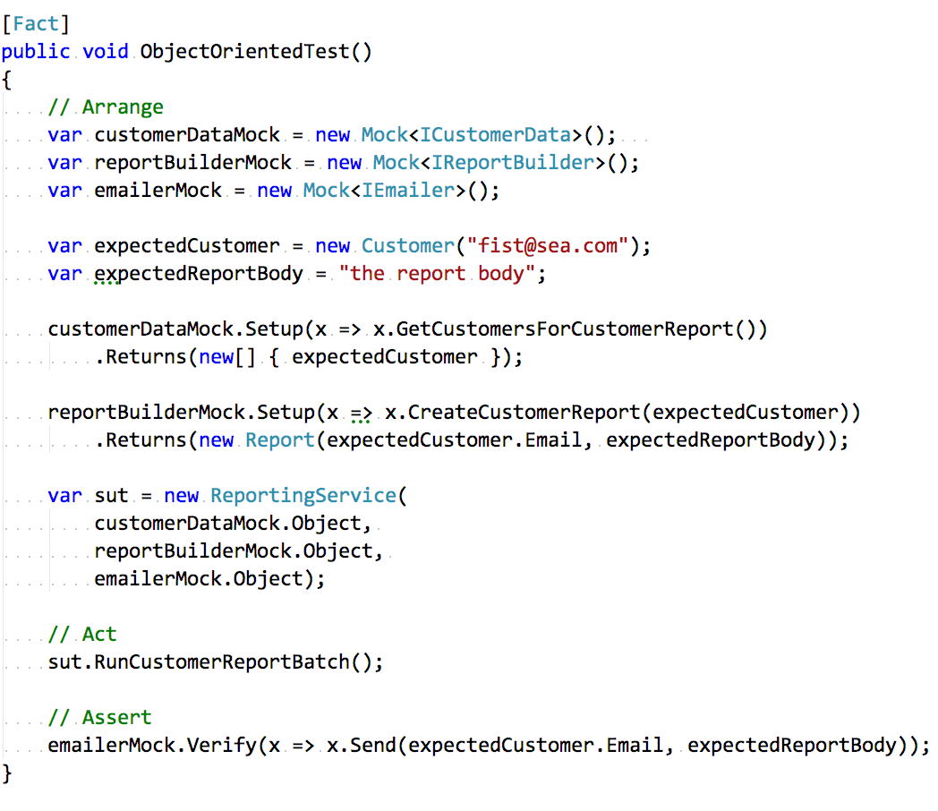

Slide 14
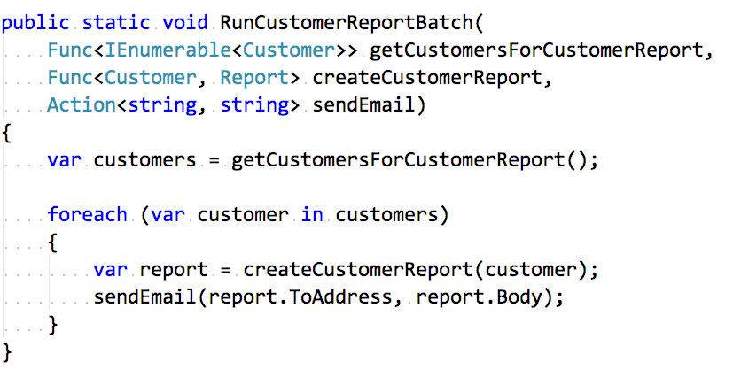

Slide 15
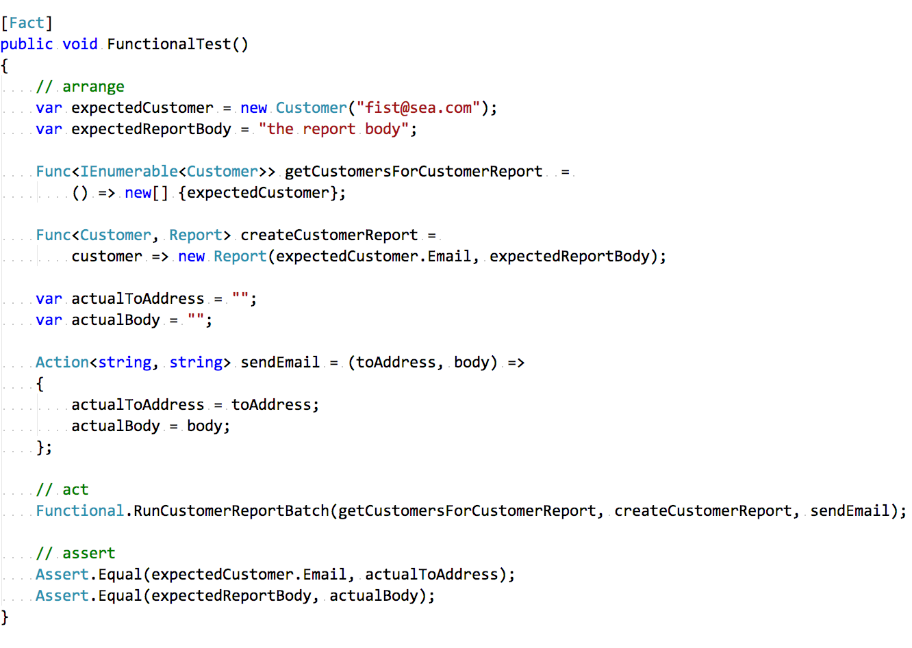

Slide 16


Demo Time…Again!
Let’s Do This!

Slide 17
Homework Time
Reading is fun
Mike Hadlow
Greg Young
01
Program Entirely in Statics - http://mikehadlow.blogspot.co.uk/2015/08/c-program-entirely-with-static-methods.html
02
The art of destroying software - https://vimeo.com/108441214
Mark Seemann
Brian Geihsler
03
SOLID the next step is functional - http://blog.ploeh.dk/2014/03/10/solid-the-next-step-is-functional/
04
Beyond SOLID: The Dependency Elimination Principle - http://qualityisspeed.blogspot.co.uk/2014/09/beyond-solid-dependency-elimination.html
Greg Young
Dan North
05
8 Lines of Code - https://www.infoq.com/presentations/8-lines-code-refactoring
06
Why Every Element of SOLID is Wrong - https://speakerdeck.com/tastapod/why-every-element-of-solid-is-wrong

Slide 18



Conclusion
You know it makes sense Rodney!
Should I still follow SOLID?
I’ve just seen something else!
It works!
Have a think to see if it still solves your problems or if there is another approach
Its productive but also enjoyable to use!
Less dependencies & more performance! Next problem please!

Slide 19

Thanks for your time!
Go forth and hack!
Source Code : github.com/jchannon/T1000
Notes:
10 points to why it’s called T1000?!

